Slide 1
Dear Associates,
Good luck for your plus one skill building !!
From :
Narayan Renga
Gautam Karandikar, Murthy Nishtala, Satish Parupati, Udesh Vaidya, Vidyanath Mudigonda

Slide 2
Core Java Introduction

Slide 3
Agenda
Introduction to Java
Programming basics
a) Conditional statements
b) Loops
c) Arrays / Strings
d) Methods

Slide 4
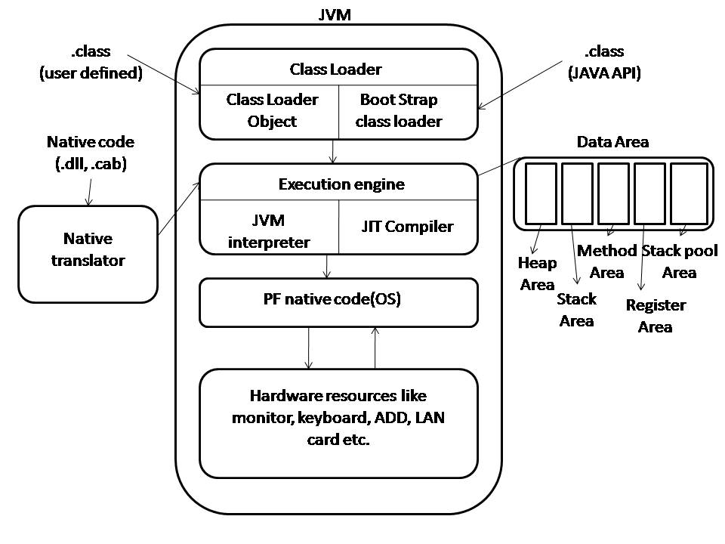
JVM Architecture

Slide 5
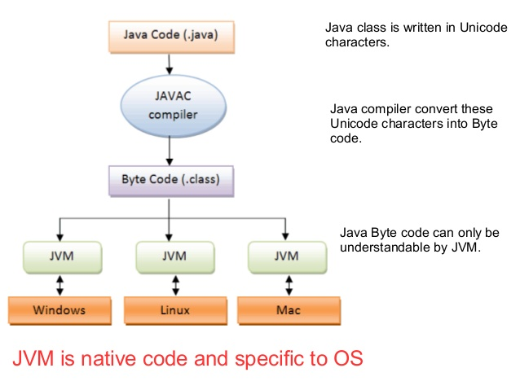
Java Execution flow

Slide 6
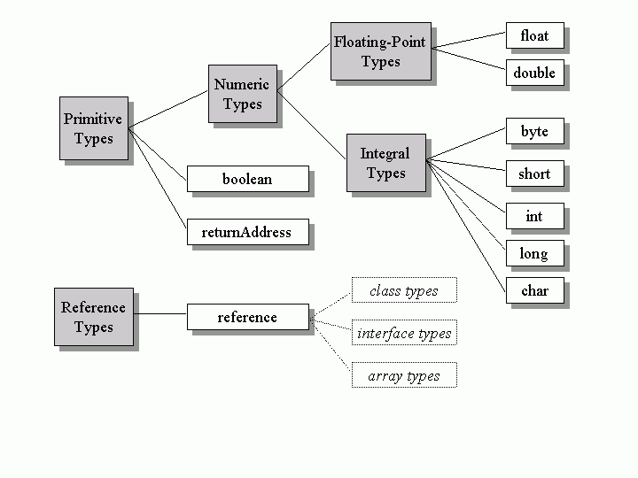
DataTypes in Java

Slide 7
Summary
Introduction to Java
JVM Architecture
Execution flow
Datatypes
Programming Basics
a) Conditional statements
b) Loops
c) Arrays / Strings
d) Methods

Slide 8
What's Next ?
Introduction to OOPS
    a) Encapsulation
    b) Abstraction
    c) Inheritance
    d) Polymorphism
Naming a Class
Preparing an Entity Class
Access Modifiers
Constructors
Getters & Setters

